Slide 1
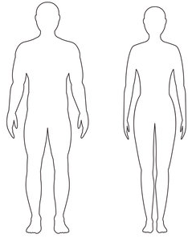
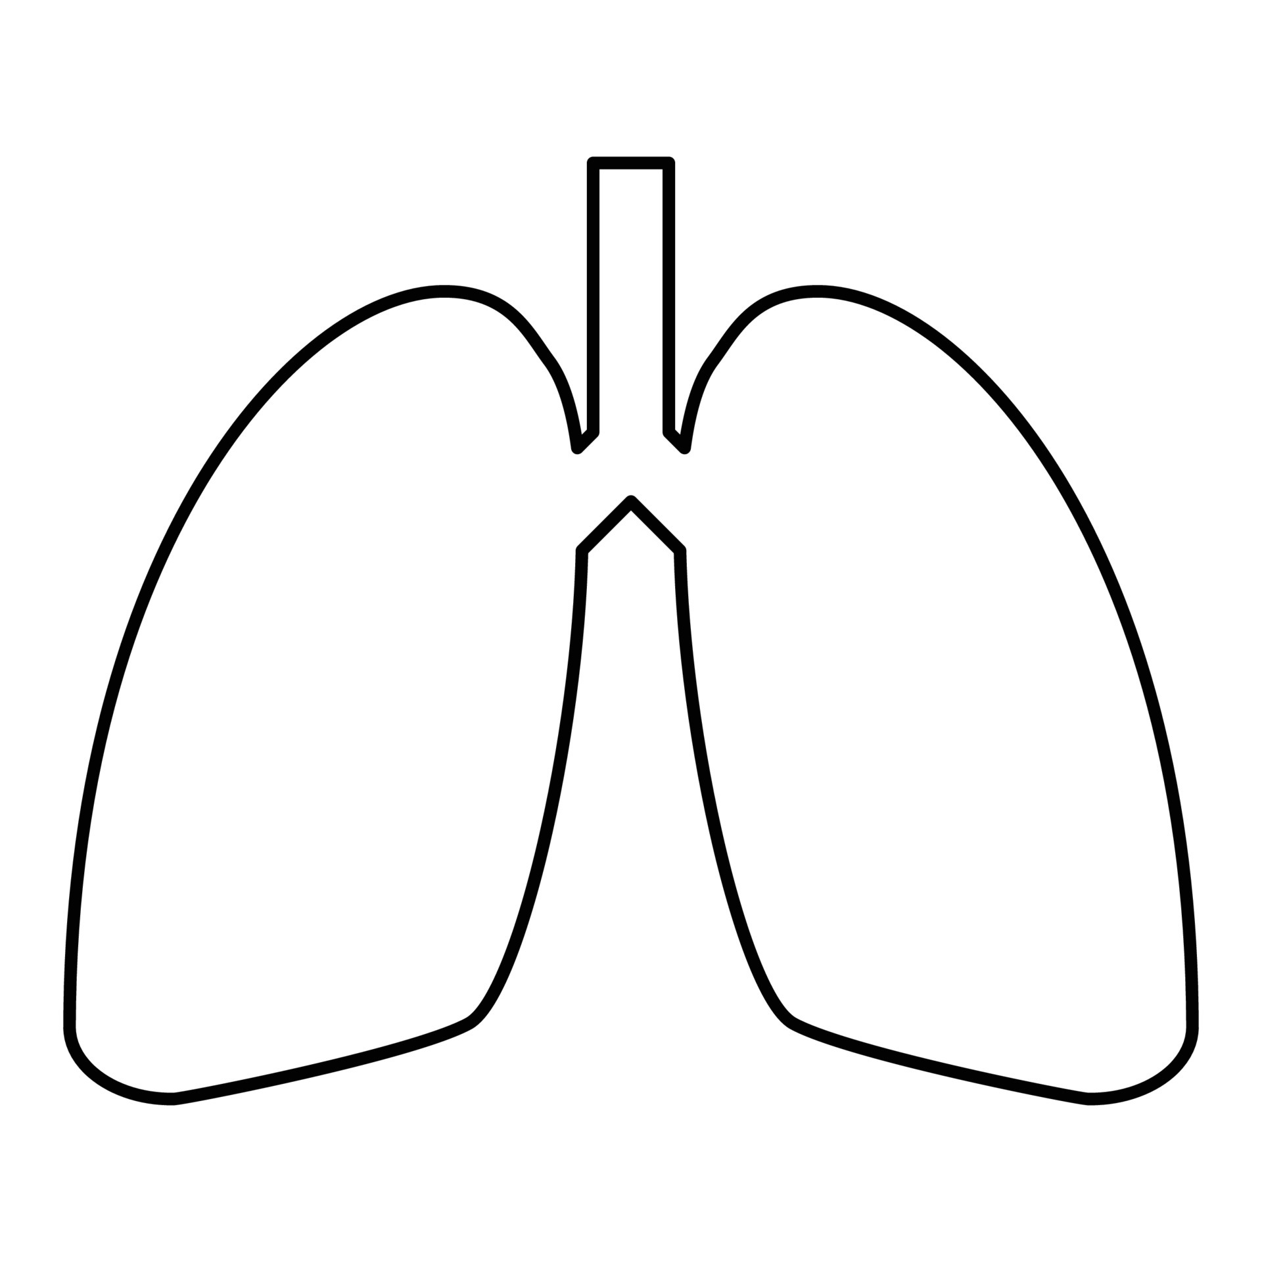
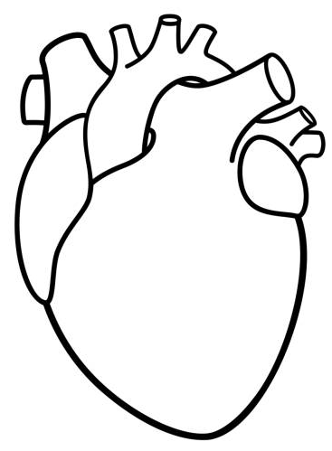
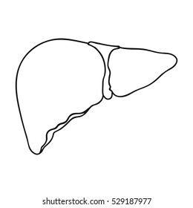
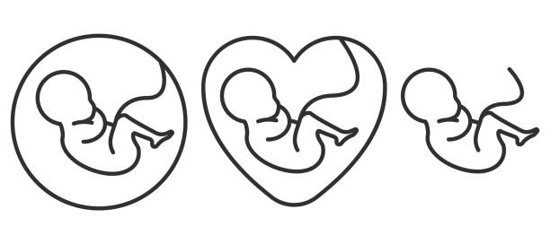
(2.16 * 10³ inhaled + 2.93 * 10¹⁰ ingested micro- and nano-plastic particles) per year
Transfer rates:
Reverse rates:
Influence of lifestyle:
Indoor air: 0.16-2.3 * 10⁶ MPs/year (sedentary lifestyle)
Half-half: indoor/2 + outdoor/2
Outdoor air: 0.46-2.1 * 10⁵ MPs/year (active lifestyle)
Aquatic products: 0.5-1.2 * 10⁴ MPs/year (seafood is part of diet)
Lung to blood
Blood to lung
Blood to muscle
Muscle to blood
Blood to placenta
Placenta to blood
Blood to intestines
About 100 to 250 grams (3 to 8 ounces) of feces are excreted by a human adult daily
0.093-16.13 ug plastic/g in feces

